Slide 1

Vidya Pratishthan’s Kamalnayan Bajaj Institute of Engineering and Technology, Baramati
INTERNSHIP IN DATA SCIENCE
Under the supervision of
Digambar Padulkar
By
Name : Dhotre Rohit Vikas
Class : TE (AI&DS)
Roll no. : 2237024
Seat no. : T190352012
ACADEMIC YEAR : (2022-2023)

Slide 2
CONTENTS
Domain
Objectives
Company Profile
Problem Statements
Methodology
Solution
Result
Advantages and Disadvantages
Conclusion
Future Scope
Certificate Of Completion

Slide 3
DOMAIN
Data Science
Combines statistical analysis, machine learning, computer science, and domain expertise
Involves using various tools and techniques to collect, process, and Analyze data, with the aim of gaining valuable insights that can inform business decisions, scientific research, and other areas.
Use statistical techniques and machine learning algorithms to Analyze large datasets, identify patterns and relationships, and make predictions. They also use data visualization tools to communicate their findings effectively.

Slide 4
OBJECTIVES
Gaining Hands-on Experience - Provide Practical Experience
Learning New Skills - New Skills and Technologies
Networking – Meet Professionals
Contributing To Projects - Work on Real-World Projects
Building A Portfolio - Showcase work & Project to Demonstrate Skills and Abilities

Slide 5
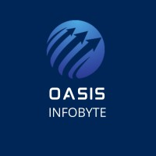
COMPANY PROFILE
Oasis Infobyte is A registered start-up, always open to connect new people with us over this journey of endless learning and great joy!
Organization turns the digital dreams of the clients into a reality. Organization works closely with the users throughout development to ensure that organization is still aligned with the end-goal. Organization is committed to producing exceptional software for each of their clients.

Slide 6
PROBLEM STATEMENTS
Task1: Iris flower classification-
Iris flower has three species – Setosa, Versicolor and Virginica, which differs according to their measurements. Now assume that you have the measurements of the iris flowers according to their species and here your task is to train a machine learning model that can learn from the measurements of their species and classify them.
Task 2: Unemployment analysis with Python-
Unemployment is measured by the unemployment rate which is the number of people who are unemployed as a percentage of the total labour force. We have seen a sharp increase in the unemployment rate during covid-19, so analyze the unemployment rate.

Slide 7
PROBLEM STATEMENTS
Task 3: Sales Prediction using Python-
Sales prediction means predicting how much of a product people will buy based on factors such as the amount you spend to advertise your product, the segment of people you advertise for, or the platform you are advertising on about your product. The task is to predict the sales with machine learning using Python.

Slide 8
METHODOLOGY USED
Task 1: Iris Flower classification:
Logistic Regression
Task 2: Unemployment analysis using Python:
Histogram, Pair-plot, Bar graph, line plot
Task 3: Sales prediction using machine learning:
Linear Regression

Slide 9
SOLUTION
Machine learning algorithms are used to classify Iris flower classification into Setosa, Virginica, and Versicolor.
Unemployment classification is done using different data visualization technique.
The machine learning algorithm, linear regression is used to predict the sales.

Slide 10
RESULT OF IRIS FLOWER CLASSIFICATION

Slide 11
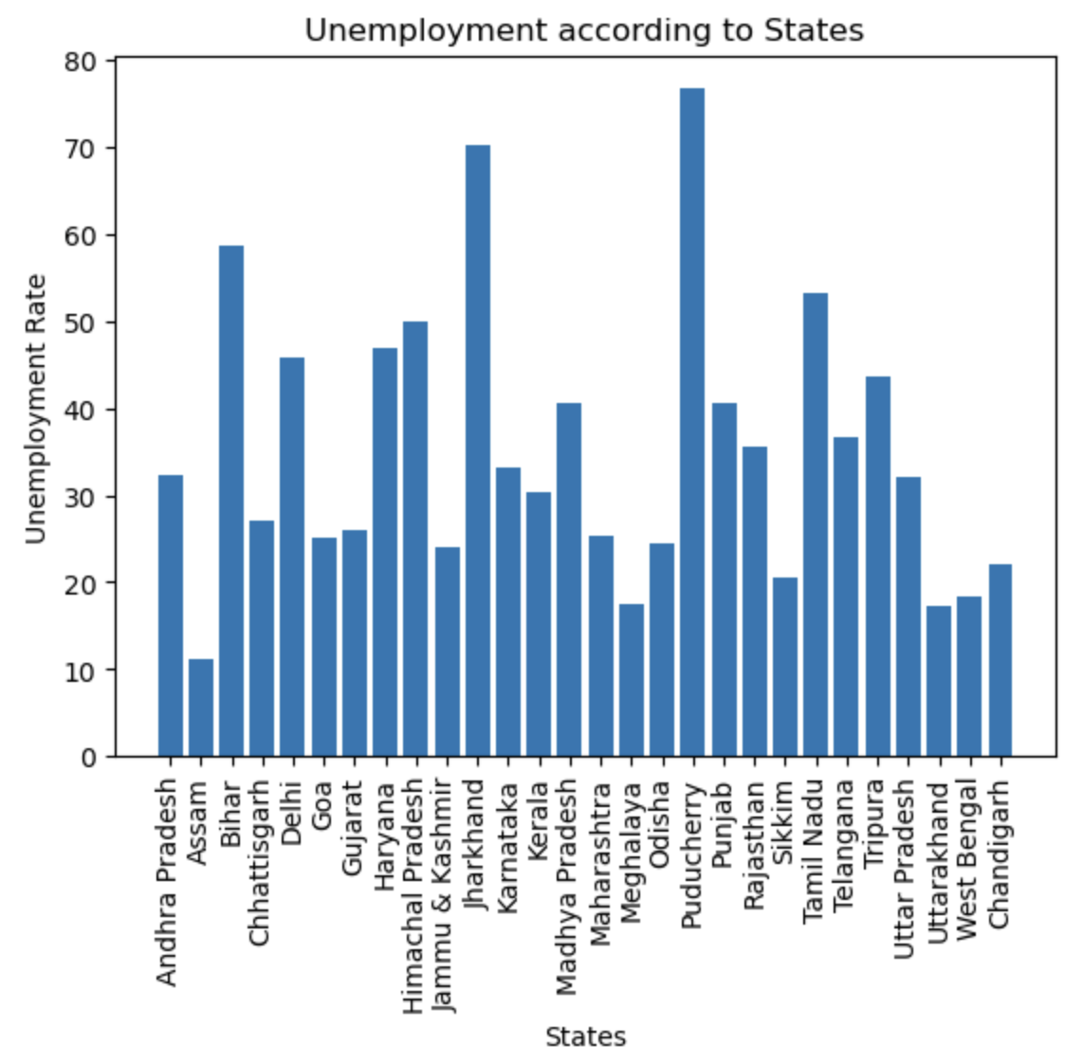
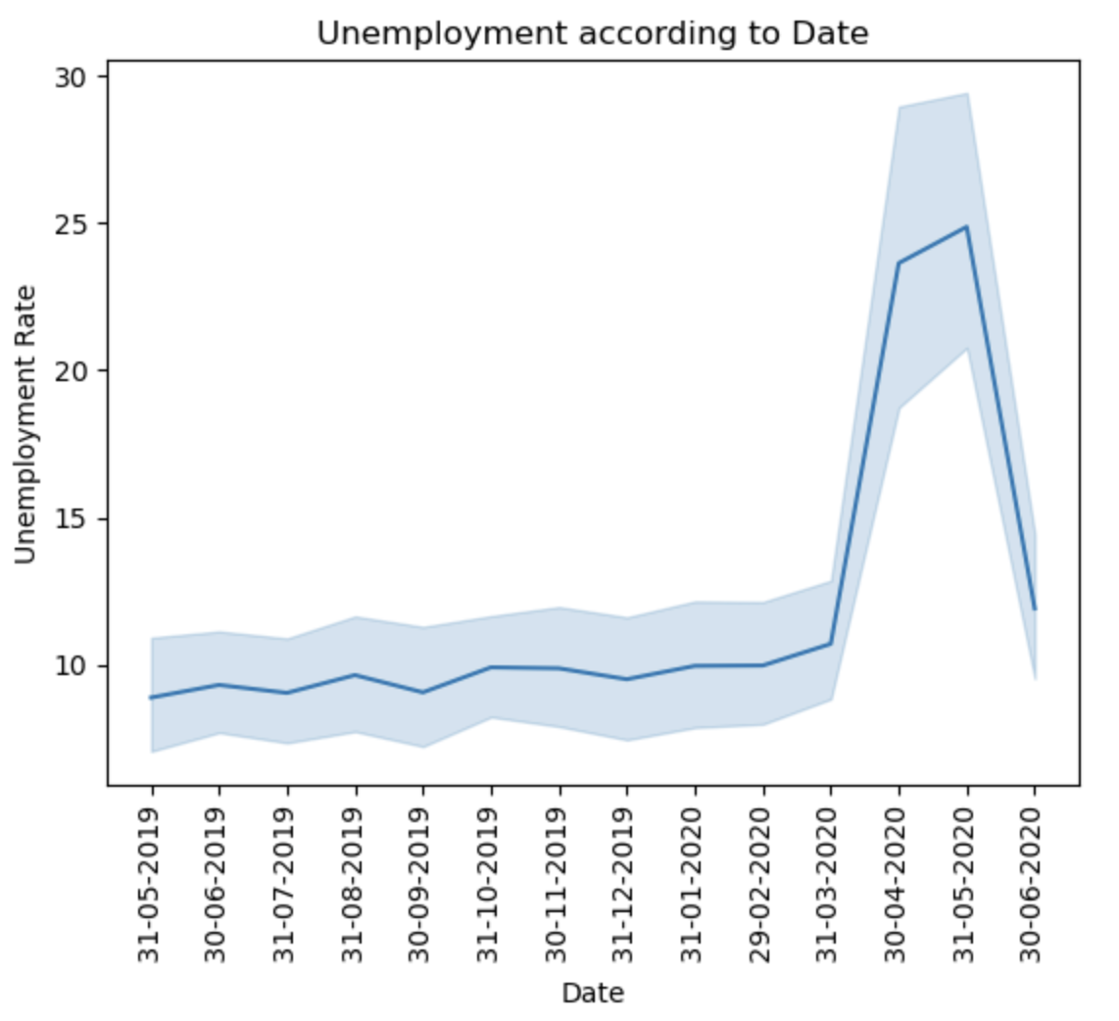
RESULT OF UNEMPLOYMENT ANALYSIS

Slide 12
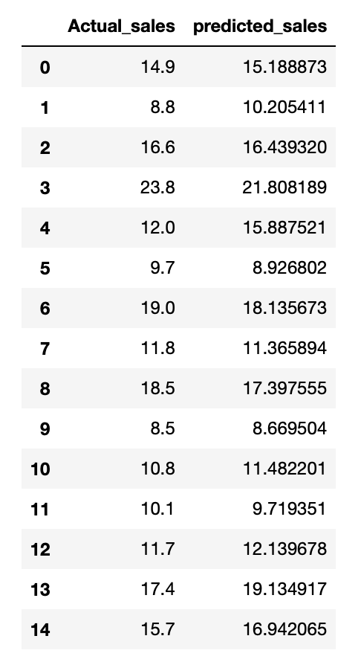
RESULT OF SALES PREDICTION

Slide 13
ADVANTAGES AND DISADVANTAGES
Advantages
Improved decision
Competitive edge
Better customer experience
Innovation
Disadvantages
Lack of quality data
Complexity
Expensive
Time-consuming

Slide 14
CONCLUSION
The internship provided an opportunity to work on real-world projects, allowing us to apply the concepts and techniques learned in the classroom to real-world problem.
The internship also emphasized the importance of data quality and data privacy in the field of data science.

Slide 15
FUTURE SCOPE
Automation - Optimize and automate processes in industries such as customer service,and manufacturing.
Artificial Intelligence - Develop models that learn and make decisions on their own.
Predictive Analytics - Make predictions about future events using historical data, with applications in finance, healthcare, and marketing.
Healthcare - Personalized treatment plans and assist in the development of new drugs and medical devices.
Education - Personalized learning and adaptive teaching approaches by analyzing data on student performance and behavior.

Slide 16
CERTIFICATE

Slide 17
THANK YOU

